Slide 1


Slide 2
ADO.net Exercise walkthrough
ADEV-2005 Programming 2
Applied Computer Education
Red River College

Slide 3
EX1. Declare Form Class Variables (Fields)
DataAdapter _dataAdapter;
Reference to a data adapter object.
DataSet _dataset;
Reference to a data set object.
BindingSource _bindingSource;
Reference to a binding source object.

Slide 4
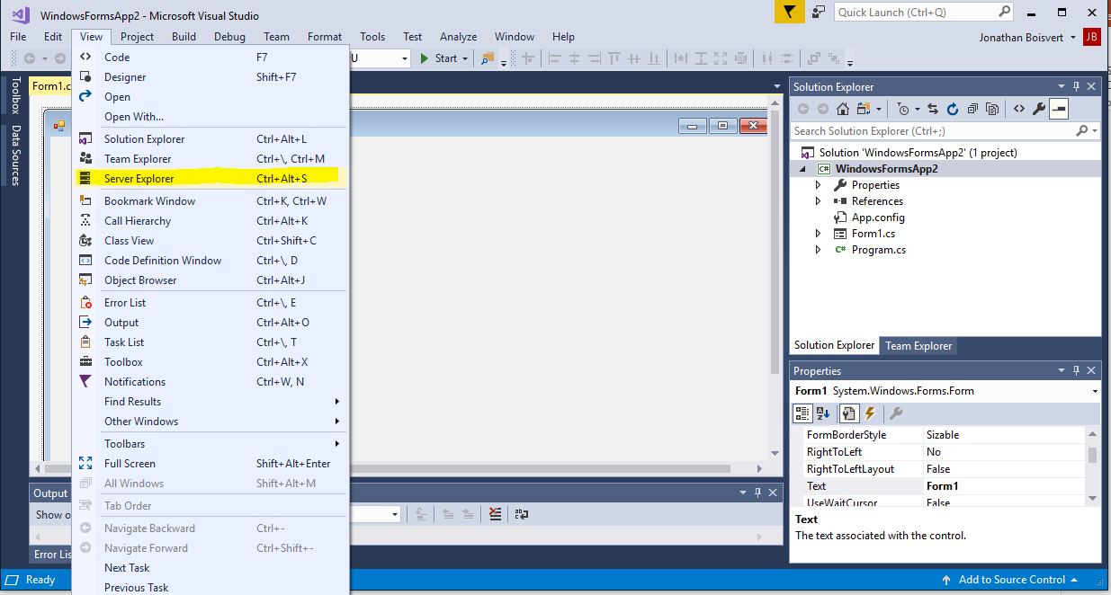
Connect to Database

Slide 5
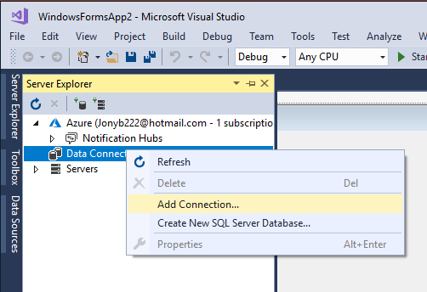
Connect to Database

Slide 6
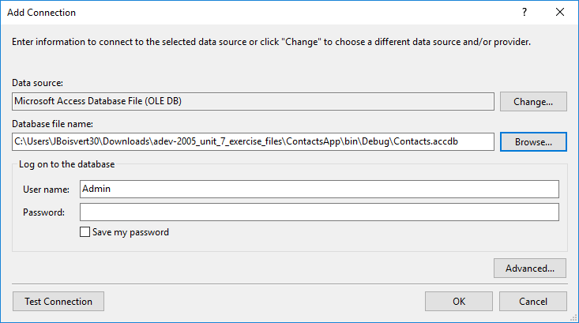
Connect to Database

Slide 7
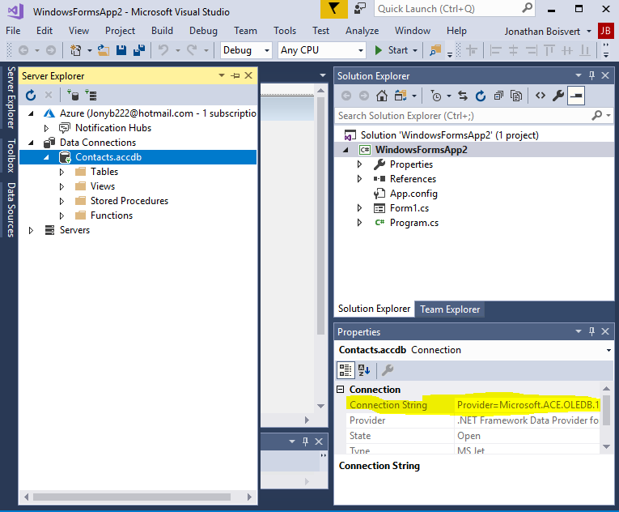
Connect to Database

Slide 8
EX2. Query the Database - create connection
1. Construct an instance of a connection object. Set the connection object’s connection string to the connection string for the provided database.
OleDbConnection connection = new OleDbConnection();
connection.ConnectionString = @“……….”;

Slide 9
EX2. Query the Database - Open Connection
2. Connection.Open();
3. Run the application
If an exception occurs, you’ve done a previous step incorrectly. -If an exception does not occur, you are on the right track.

Slide 10
EX2. Query the Database - Create Command
4. Construct an instance of a command object. Set the command object’s command text to the SQL required to query all rows and columns from the Contacts table. The command object will also need a reference to the connection object.
OleDbCommand command = new OleDbCommand();
command.CommandText = "SELECT * FROM Contacts;";
command.Connection = connection;

Slide 11
EX2. Query the Database - Create Command
5. Construct an instance of a data adapter object. Set the data adapter object’s select command to the command object constructed in step 4.
OleDbDataAdapter adapter = new OleDbDataAdapter();
adapter.SelectCommand = command;

Slide 12
EX2. Query the Database - Create Command
6. Construct an instance of a data set object.
7. Using the data adapter object, fill the data set. Give the table a name of “Contacts”.
DataSet dataSet = new DataSet();
adapter.Fill(dataSet, "Contacts");

Slide 13
EX2. Query the Database - Create Command
8. Run the application.
If an exception occurs, you’ve done a previous step incorrectly.
If an exception does not occur, you are on the right track.

Slide 14
EX3. Populate DataGridView
1. Construct an instance of a binding source object.
2. Handle the Load event of the Form.
BindingSource source;
this.Load += new System.EventHandler(this.Form1_Load);
private void Form1_Load(object sender, EventArgs e) { … }

Slide 15
EX3. Populate DataGridView
In the handler method, code the following:
1. Set the binding source’s data source to the “Contacts” table in the data set.
2. Set the data grid view’s data source to the binding source object.
_source.DataSource = _dataSet.Tables["Contacts"];
dataGridView1.DataSource = _source;

Slide 16
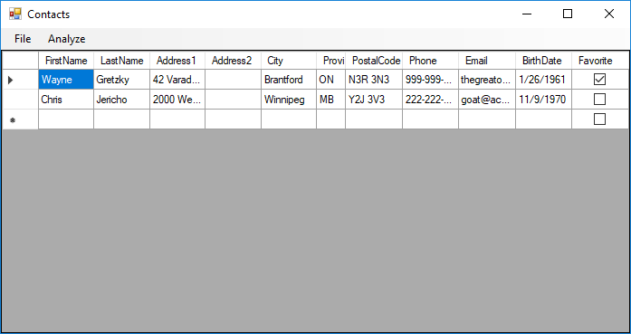
EX3. Populate DataGridView
3. Run the Application
Two records will appear in the data grid view along with an empty row for adding new records.
If no records appear,
check your SQL query
or the data binding.
If an exception occurs,
you’ve done a previous
step incorrectly.

Slide 17
EX3. Populate DataGridView
4. Set the “ID” column in the data grid view such that it is hidden.
dataGridView1.Columns["ID"].Visible = false;
5. Run the application and confirm the “ID” field is not visible.
6. Handle the Save main menu item’s Click event.

Slide 18
EX4.Updating the Database
In the Save button Click event handler, code the following:
Using the data adapter, update the DataSet. You will need to specify that the table “Contacts” will be updated.
Run the application:
Edit any cell in either row. Press the Tab key or click another cell to end the edit.
Click the Save main menu item or Ctrl+S.
Exit the application.
private void mnuFileSave_Click(object sender, EventArgs e)
{
_adapter.Update(dataSet.Tables["Contacts"]);
}

Slide 19
EX4.Updating the Database
The edit you made was not saved to the database. Why?

Slide 20
EX4.Updating the Database
In the constructor for the form class, add the following code:
Construct an instance of a command builder object. Set the command builder object’s data adapter to the instance of the data adapter.
Use the command builder to set the other three data adapter commands.
Run the application:
Edit any cell in either row. Press the Tab key or click another cell to end the edit.
Click the Save main menu item or Ctrl+S.
Exit the application.
_builder = new OleDbCommandBuilder();
_builder.DataAdapter = _adapter;
_adapter.DeleteCommand = _builder.GetDeleteCommand();
_adapter.UpdateCommand = _builder.GetUpdateCommand();
_adapter.InsertCommand = _builder.GetInsertCommand();

